Slide 1
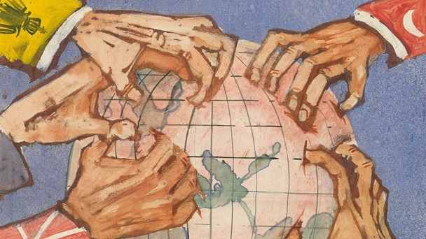
FIRST WORLD WAR
1914 - 1918
FIRST WAR : TWO GROUPS
28TH JULY1914 – 11TH NOVEMBER 1918
CENTRAL POWERS : ALLIED POWERS

Slide 2
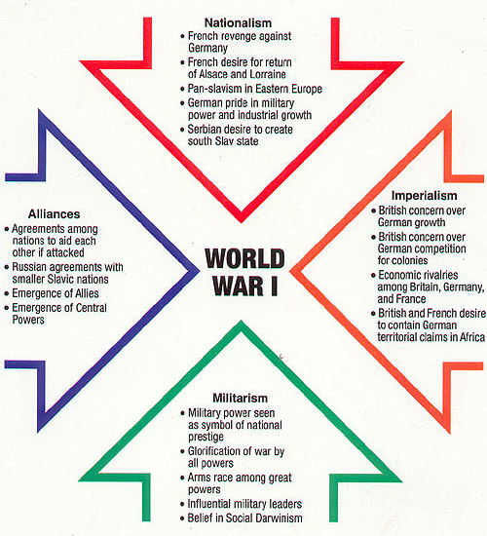
CAUSES
NATIONALISM
MILITARISM
IMPERIALISM
ALLIANCES
TRIPLE ALLIANCE: 1904 : GERMANY+AUSTRIA+ITALY+TURKEY
TRIPLE ENTENTE: 1907 : FRANCE+RUSSIA+ENGLAND+JAPAN

Slide 3
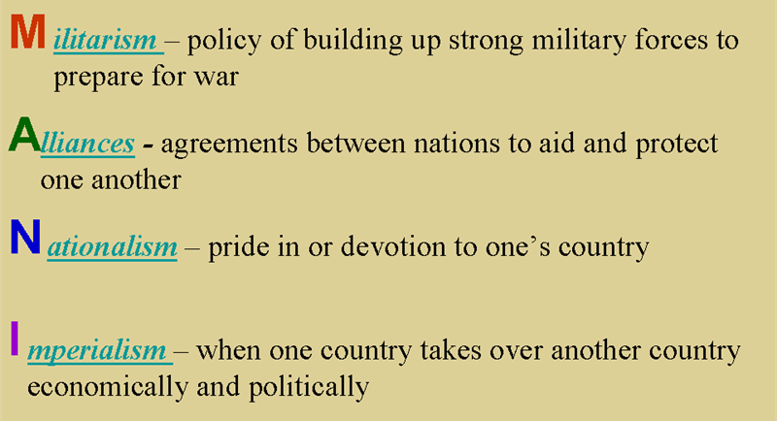
CAUSES

Slide 4
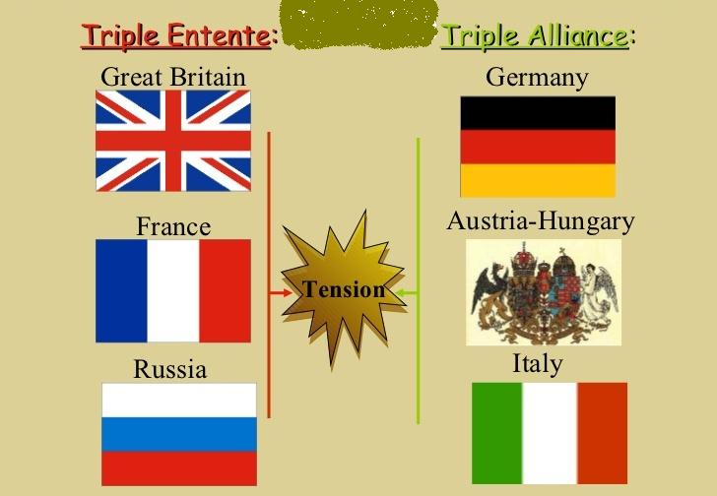
CAUSES

Slide 5
CAUSES
AMBITION OF GERMAN EMPEROR WILLIAM II
FRENCH DESIRE FOR ALSACE LORRAINE
PRUSSIAN SPIRIT
LACK OF INTERNATIONAL MACHINERY
IMMEDIATE CAUSE
ASSACINATION OF ARCHDUKE FERDINAND
AUSTRIA X SERBIA, BOSNIA-NEIGHBOUR TO SERBIA- FRIEND TO AUSTRIA- AUSTRIAN CROWN PRINCE- TO BOSNIA- TOWN HALL TO CITY MUSEUM- SERBIAN YOUTH- 28TH JUNE 1914- ULTIMATUM TO SERBIA 28TH JULY

Slide 6
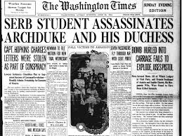

Slide 7
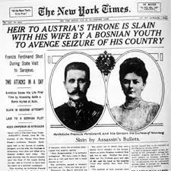


Slide 8
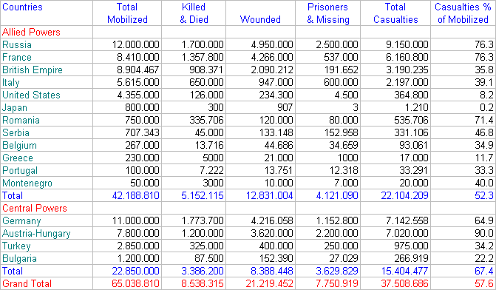
EVENTS….
AUSTRIA DECLARED WAR ON SERBIA ON 28TH JULY
GERMANY SUPPORT AUSTRIA X RUSSIA SUPPORT SERBIA

Slide 9
RESULTS…
PARIS PEACE CONFERENCE- 1919
HUMILIATING TREATIES
VERSAILLES WITH GERMANY- 1919
SAINT GERMAIN WITH AUSTRIA- 1919
NEUILLY WITH BULGARIA- 1919
TRIANON WITH HUNGARY- 1920
SEVRES WITH TURKEY- 1920
ESTABLISHMENT OF LEAGUE OF NATIONS- 1920
EECONOMIC BURDEN AND PROBLEMS
POLITICAL INSTABILITY IN EUROPE

